Slide 1
1 bit Transceiver for Radar chirps
Michael Medrano

Slide 2
Motivation
Latest radiation-tolerant Xilinx FPGAs have 12.5Gbps transceivers
Each transmitter can be used as a 1-bit DAC for waveform generation;
Pulsed square waves (filtered to generate pulsed sinusoids)
Phase coded waveforms
Linear FM chirps
Non-linear FM chirps (which support frequency domain shaping)
Direct generation at L-band, S-band, C-band, and X-band
Reduce Size Weight and Power (SWaP)
Eliminate multi-bit digital-to-analog converters
Eliminate analog mixers

Slide 3
What we’re trying to do
We’re investigating what it takes to get chirps equivalent to those generated by a multi-bit DAC. The multi-bit DAC we are comparing to, is the ADRV9009.
Our design uses 1 bit DAC whose lane rate is much larger than the chirp bandwidths (O(3)). The transceiver behaves like a 1-bit DAC with oversampling.
We’re comparing chirps from the ADRV9009 DAC to the combination of 1-bit oversampled DAC and filtering from the transceiver.

Slide 4
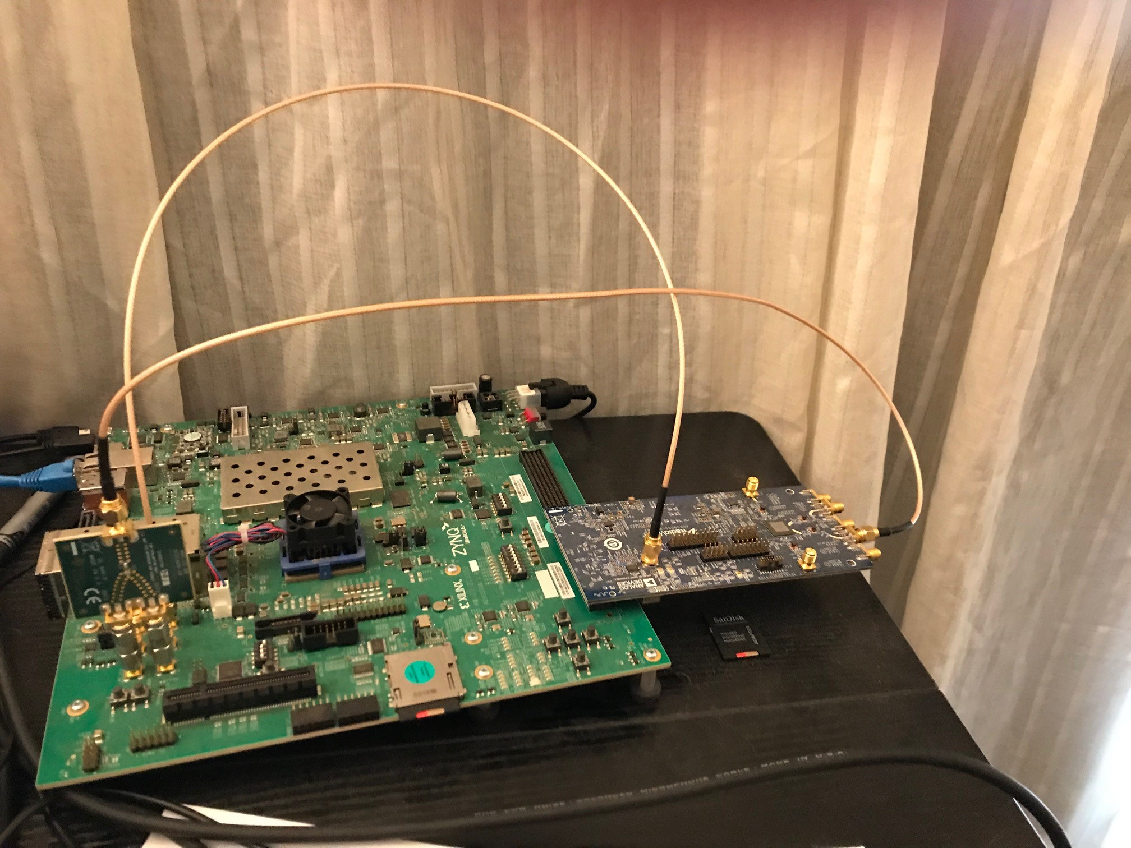
Development Platform
Working at home during COVID
Xilinx Zynq UltraScale+ ZCU102 Board
Analog Devices ADRV9009 Software Defined Radio (DAC + ADC) board with 75MHz to 6GHz operating range
Excellent software support:
Real-time data capture
Python programming
ADRV9009 ADCs used for data capture
ADRV9009 DACs used to generate multi-bit waveforms to compare to the 1-bit generated waveforms
UltraScale+ transceivers used as 1-bit DAC
UltraScale Transceiver
Transmitter Outputs
ADRV9009
Reference
ADRV9009 ADC
Inputs

Slide 5
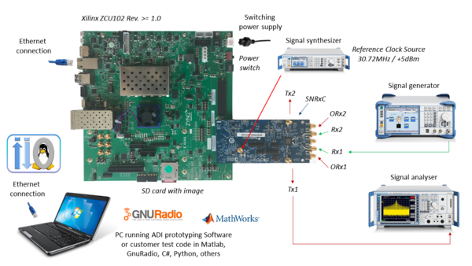
Building With PetaLinux
Petalinux is a toolchain that can be used to build a Linux OS for ZynqMP based on custom device tree
Stable reference design for the ZCU102-ADRV9009 OS was branch 2018.3- so I used, Vivado, SDK, and PetaLinux 2018.3

Slide 6
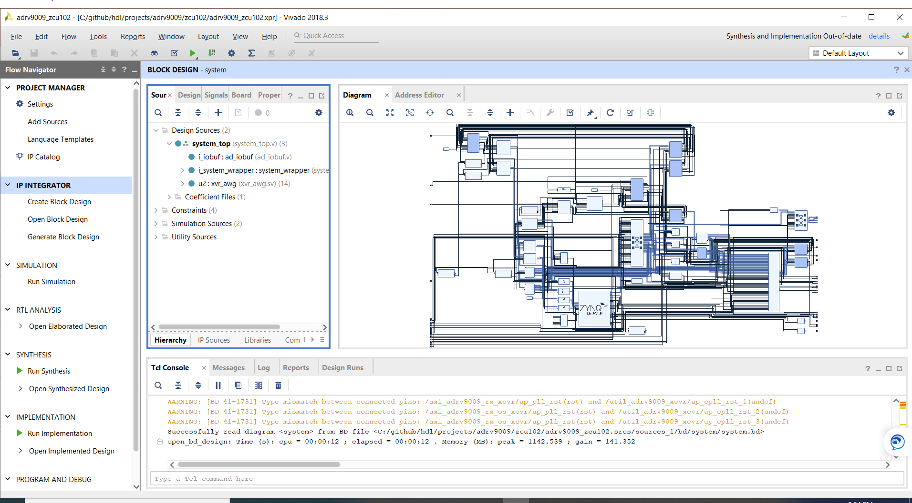
Building the HDL in Vivado
First step was to clone the hdl repo from Analog Devices and Generate Bitstream in Vivado

Slide 7
Building with PetaLinux
Use the design generated from Vivado and include in a petalinux project.
Do a petalinux-build
petalinux-package to make the image products
Put BOOT.bin, image.ub and the file system onto the sd card and boot the zcu102 from the sd card.

Slide 8
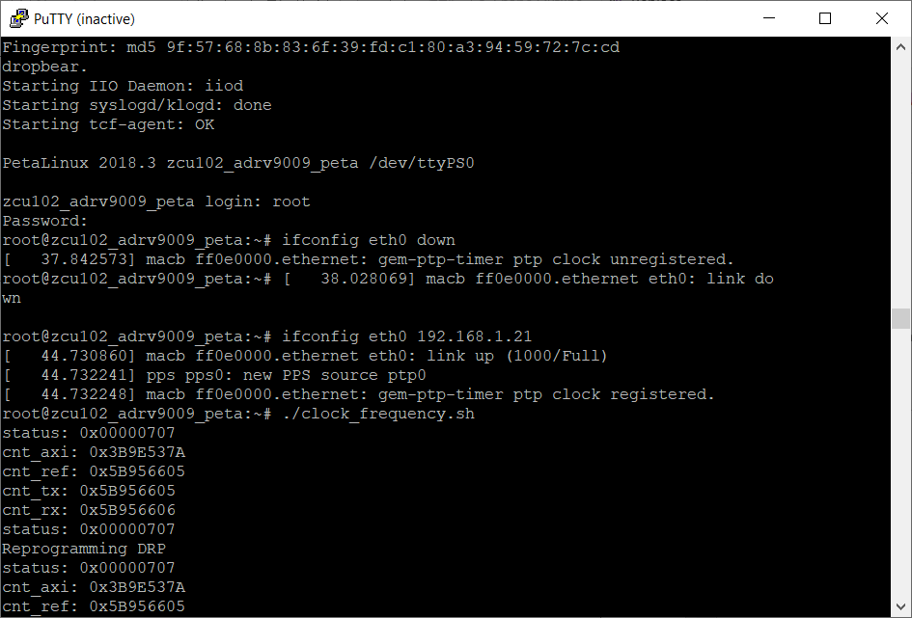
The bash terminal via serial UART

Slide 9
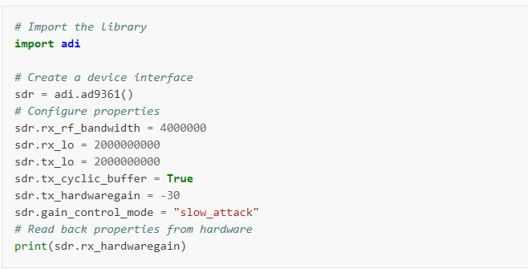
Using pyADI to automate data collection/analysis
pyADI-IIO: allows you to write configuration params, write to the ADRV9009 DAC and ADC by writing to the member variables in device specific classes

Slide 10
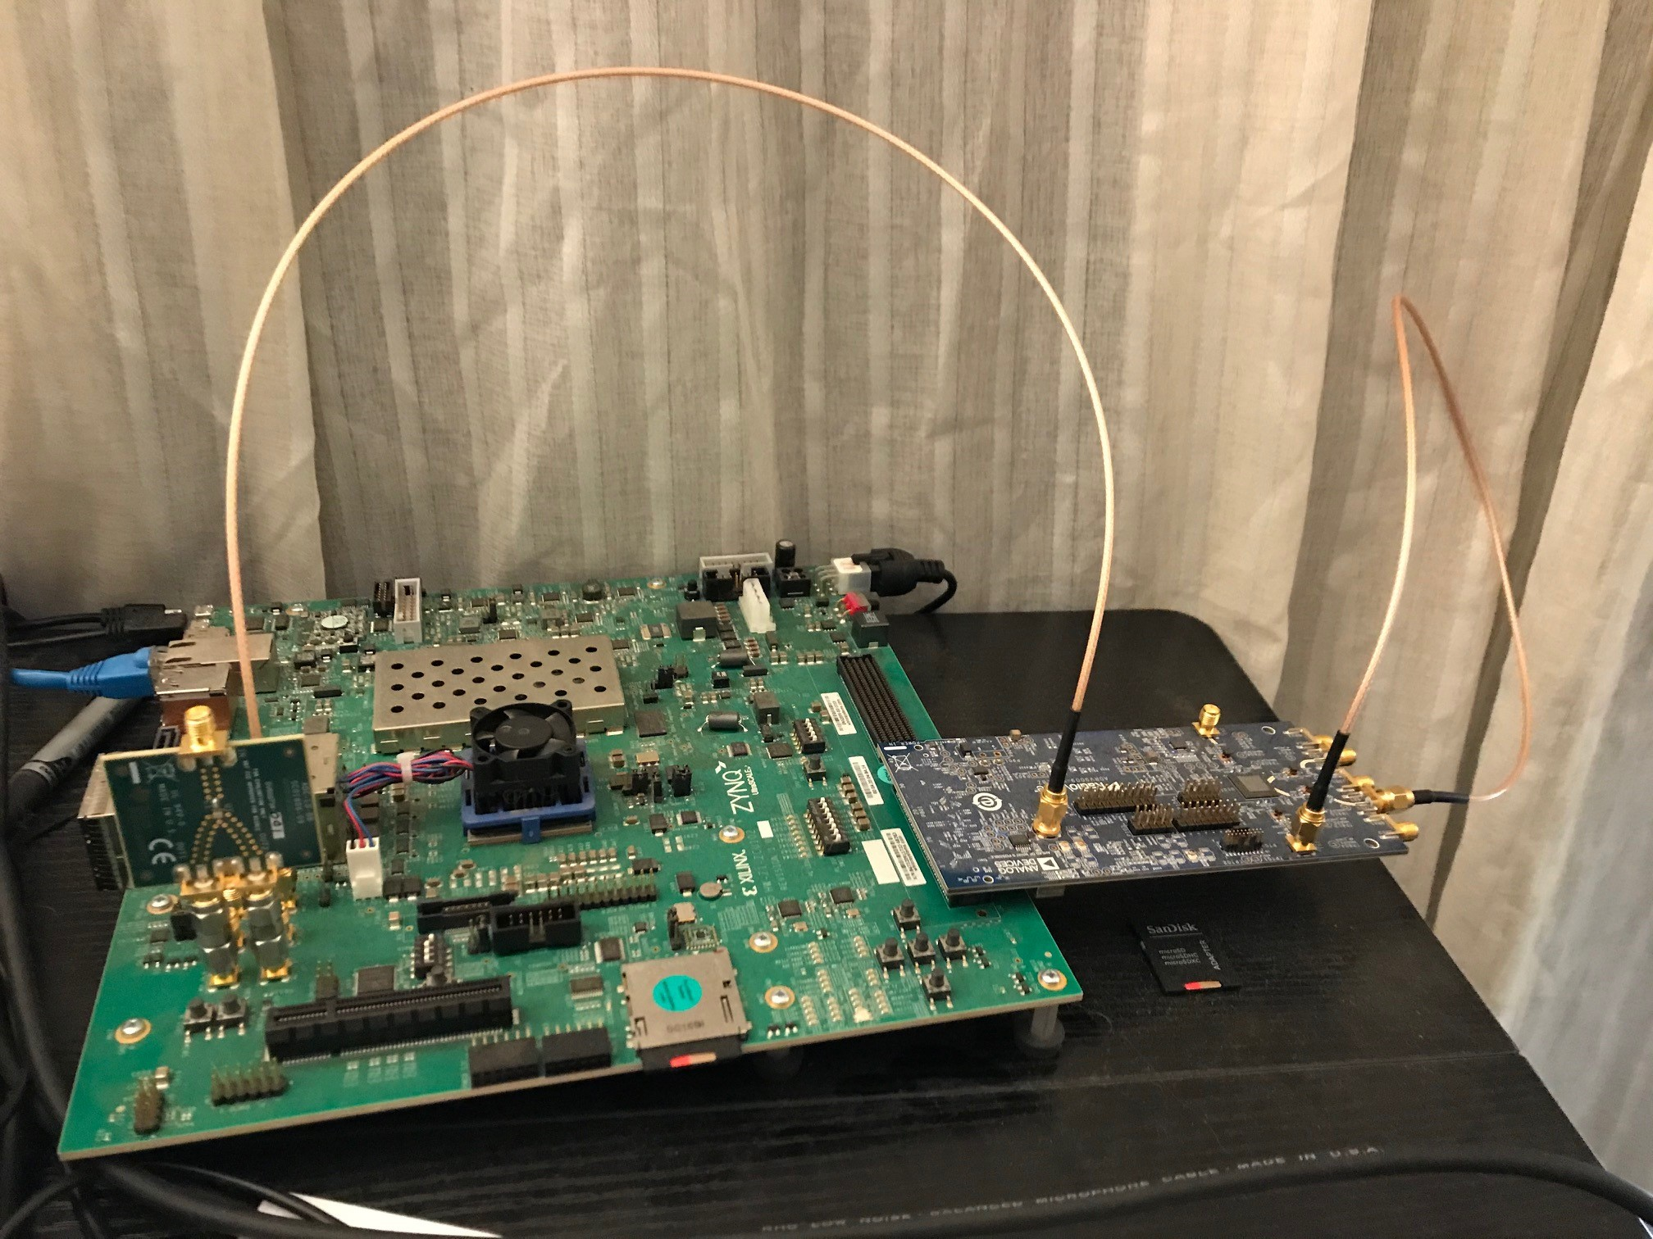
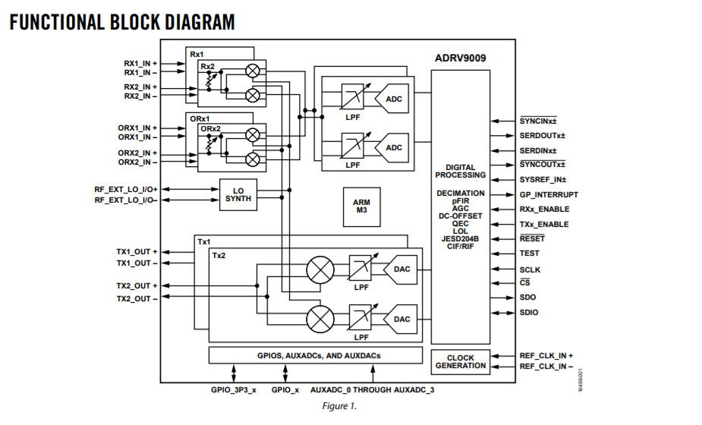
Building the Data Collection Tool by patching ADRV9009 DAC to ADC
Sampled at 245.76 MHz
ADRV9009 DAC
ADRV9009 ADC

Slide 11
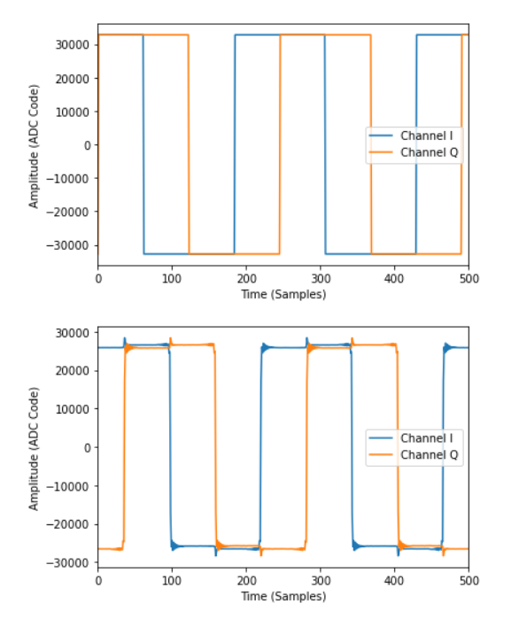
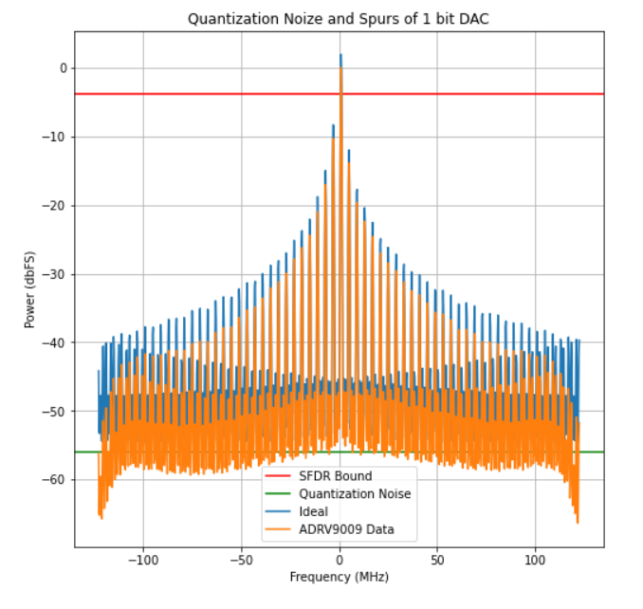
Quantization SFDR using the ADRV9009 DAC/ADC – 1 Bit
SFDR = 6.02*B - 2.32
SQNR = 6.02*B + 1.76 + 10*log10(N/2)
+ 20*log10(w_cg/w_ig)

Slide 12
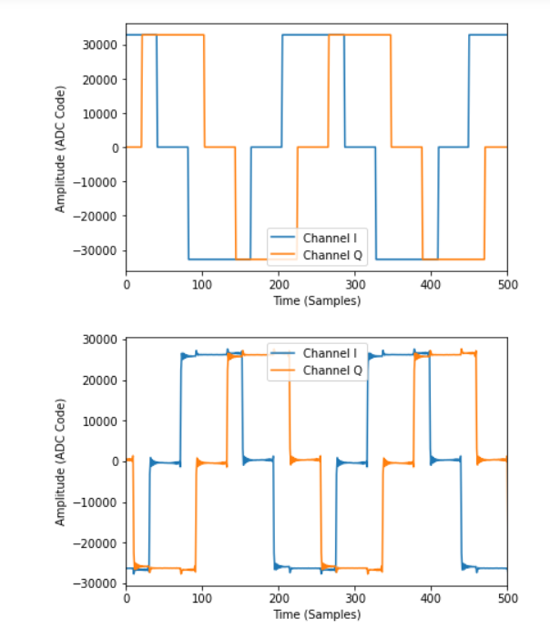
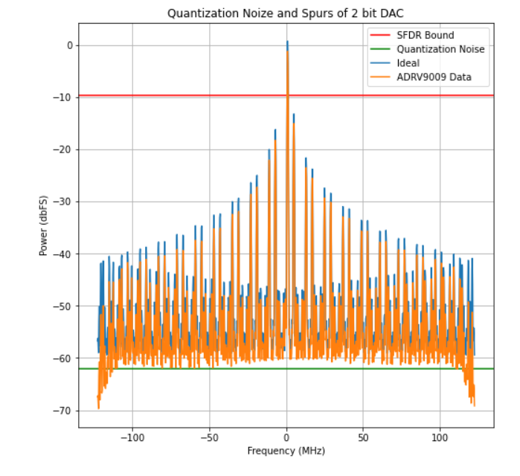
Quantization SFDR using the ADRV9009 DAC/ADC – 2 Bit

Slide 13
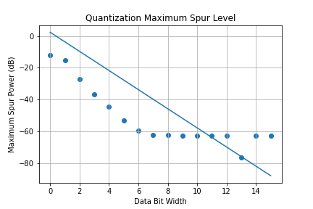
Quantization SFDR using the ADRV9009 DAC/ADC

Slide 14
Chirp Parameters
F_center : center frequency of the chirp
B_chirp : bandwidth of the chirp
T_chirp : time duration of the chirp
RX_sample_rate: Sample rate of the ADRV9009 ADC (245.76 MHz)
F_LO: the LO frequency of the ADRV9009
TX_sample_rate: Sample rate of the Transceiver/ADRV9009 DAC (6.144 GHz /245.76 MHz)

Slide 15
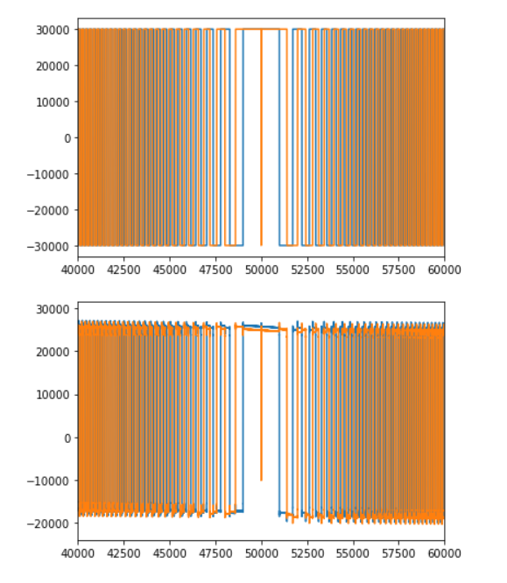
Chirp Analysis with ADRV9009 DAC/ADC
Time Domain:
p(t) = rect(t/Tc)*exp(j*2*pi*(f0*t + 1/2*Kc*t^2))
Frequency Domain:
P(f) = rect((f-f0)/Bc)*sqrt(j/Kc)*exp(-j*pi*(f-f0)^2/K)

Slide 16
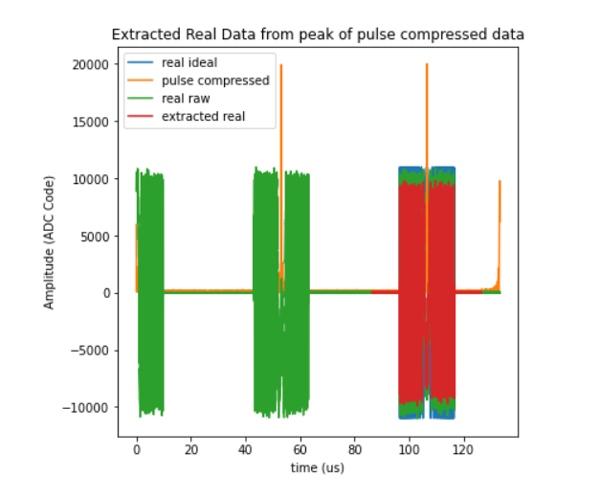
Chirp Extraction ‘Triggering’ using Pulse Compression
Pulse Compression:
C(f) = P(f)*exp(j*pi*(f-f0)^2/K)/sqrt(j)
Used to extract the ‘best’ chirp from a stream of chirp data.
picked the chirp with the largest pulse compressed peak.
Grabbed 2N samples around the chirp

Slide 17
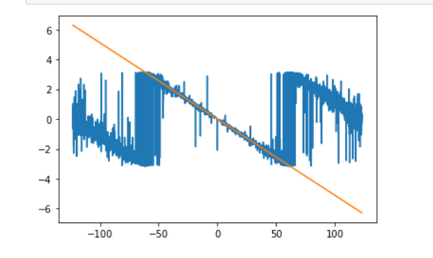
Time Jitter In extracted Samples
The start time of the extracted chirp jitters making incoherent averaging impossible.
Fourier shift theorem is:
A time domain shift: s(t – tau)
Fourier transforms to: S(f)*exp(-j*2*pi*f*tau)
Given, X1 and X2 the FFT of capture 1 and 2
Y2 = X2.*conj(X1)
np.angle(Y2)
Line Fit: -2*np.pi*f*tau +b
Where slope: tau = 1/F_sample*a*1e6 and a is int delay
Phase
Frequency

Slide 18
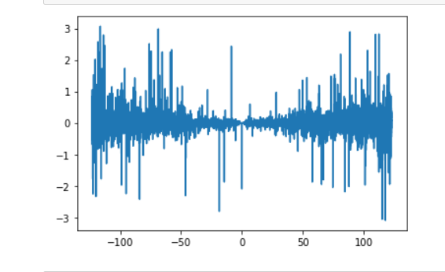
Fixing Time Jitter In extracted Samples
Fixing the delay uses tau:
X2_fixed = X2.*exp(+j*2*pi*f*tau)
Then plotting Y2 = X2_fixed.*conj(X1)
Then time domain fixed waveform can be found using x2_fixed = ifft(X2_fixed)
Phase
Phase
Frequency

Slide 19
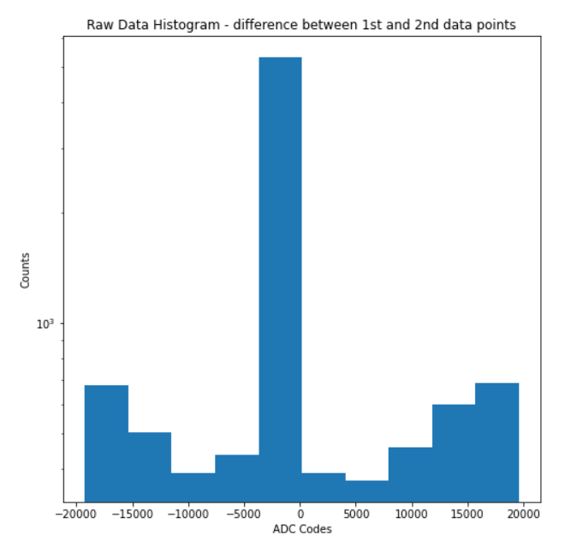
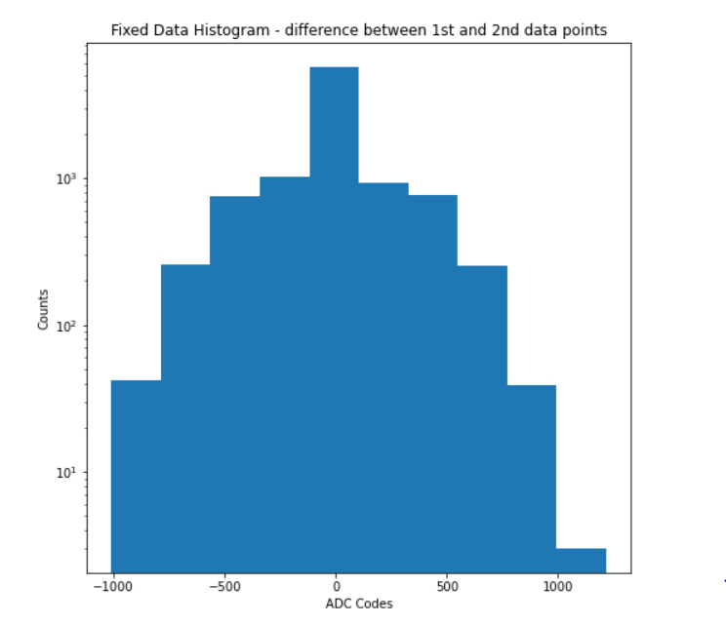
Comparison Time Jitter In extracted Samples Before and After
Plot histograms of x1-x2 and x1-x2_fixed.
The difference involving the ‘fixed’ waveform is more gaussian.

Slide 20
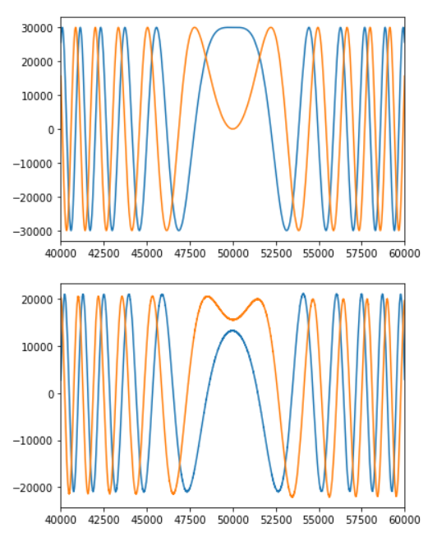
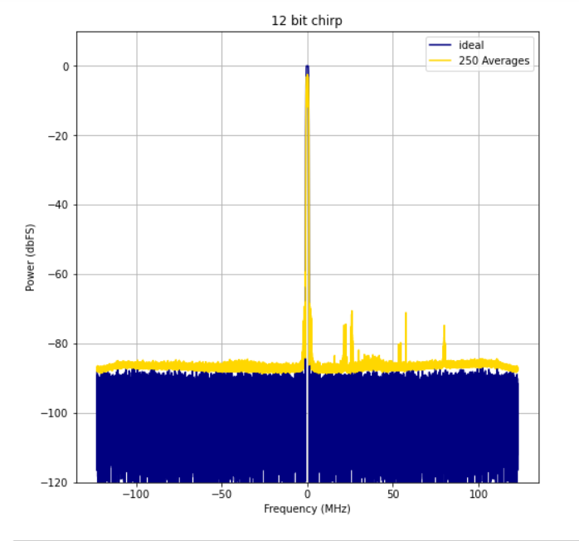
Incoherent Averaging of Chirps From the ADRV9009 DAC/ADC

Slide 21
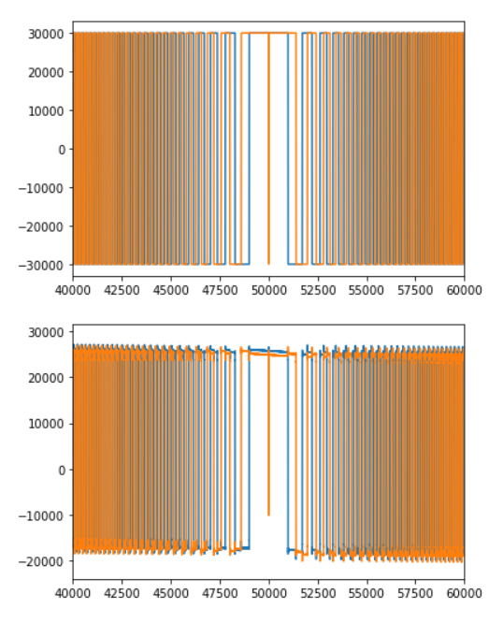
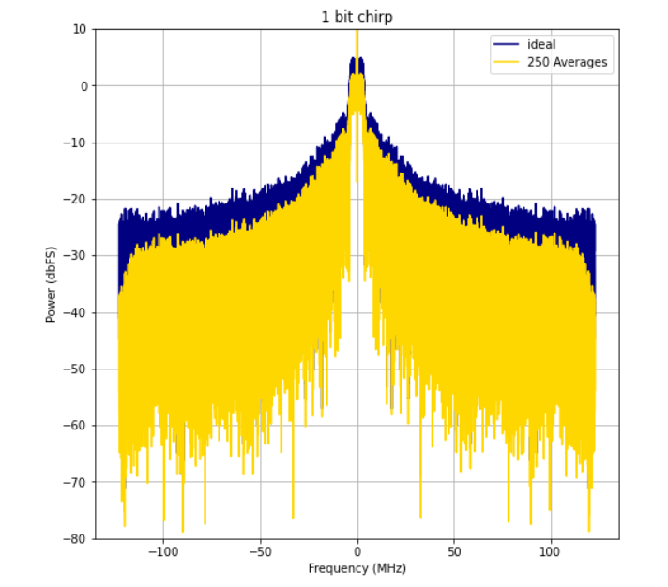

Slide 22
1 Bit Transceiver Setup
Wrote a testbench to simulate/ and tested hardware reads/writes over jtag.
Put the 1 bit transceiver design into the original Analog Devices Design.
UltraScale Transceiver
Transmitter Outputs
ADRV9009
Reference
ADRV9009 ADC
Inputs

Slide 23
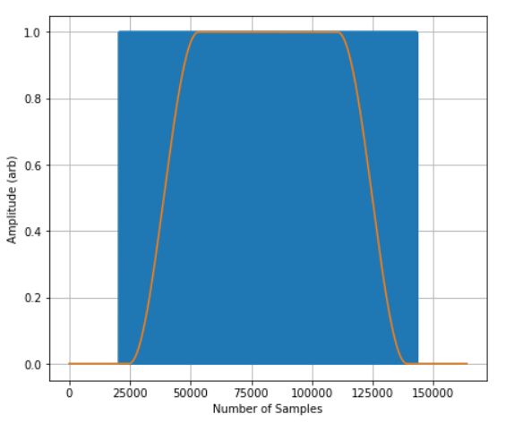
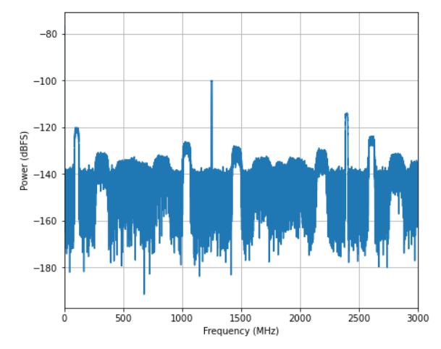
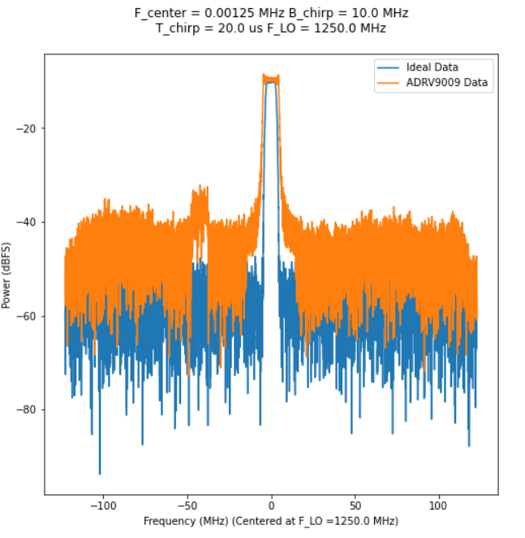
Transceiver Chirps
Comparison Ideal FFT and incoherent
average N=200 of ADRV9009 data
Time Domain with Windowing Function
FFT of ideal waveform

Slide 24
Current Status and Path Forward
Zynq Development Environment working;
Xilinx FPGA design tools, software design tools, PetaLinux build
Analog Devices github projects, and communications tools
ADRV9009 characterized for sinusoids and chirps
UltraScale Transceiver “Arbitrary Waveform Generator”
Integrated into the design
Software development in progress
Linear FM chirp waveforms to be captured and analyzed
Future work
Hardware testing with Class-D (saturation) amplifiers, eg., NISAR TRM

